Slide 1
Gym Management System
SAI PRATHYUSHA
HARSHITA

Slide 2
Abstract
Finding a good gym in less time can sometimes seems like an impossible task. You should first search then visit for enquiry of availability and services and after a long struggle you go with the booking or might not.
“Gym Management System” is a web-based gym management application with package booking functionality. In this system user can make a package booking online and view the package information in detail. They can do a gym tour virtually and can also see various equipment’s present in gym. They can become a member of the gym and enjoys multiple services. By becoming a member, they can view yoga videos, zumba videos, diet plan. User sees the details of gym and can contact the gym authority. A google map is also provided for allowing users to find available route through driving, public transportation or walking.
In this system, owner give details of the services they offer and also describe the services in detail.
This software help website admin to see all the details in brief like login, bookings, payments, messages received and trainer data.
Based on the result, it was found online booking is more convenient than manual system. As it is easier and reduce time taking process. So, because of this gym management system many users can manage their good health even in their busy schedules.

Slide 3
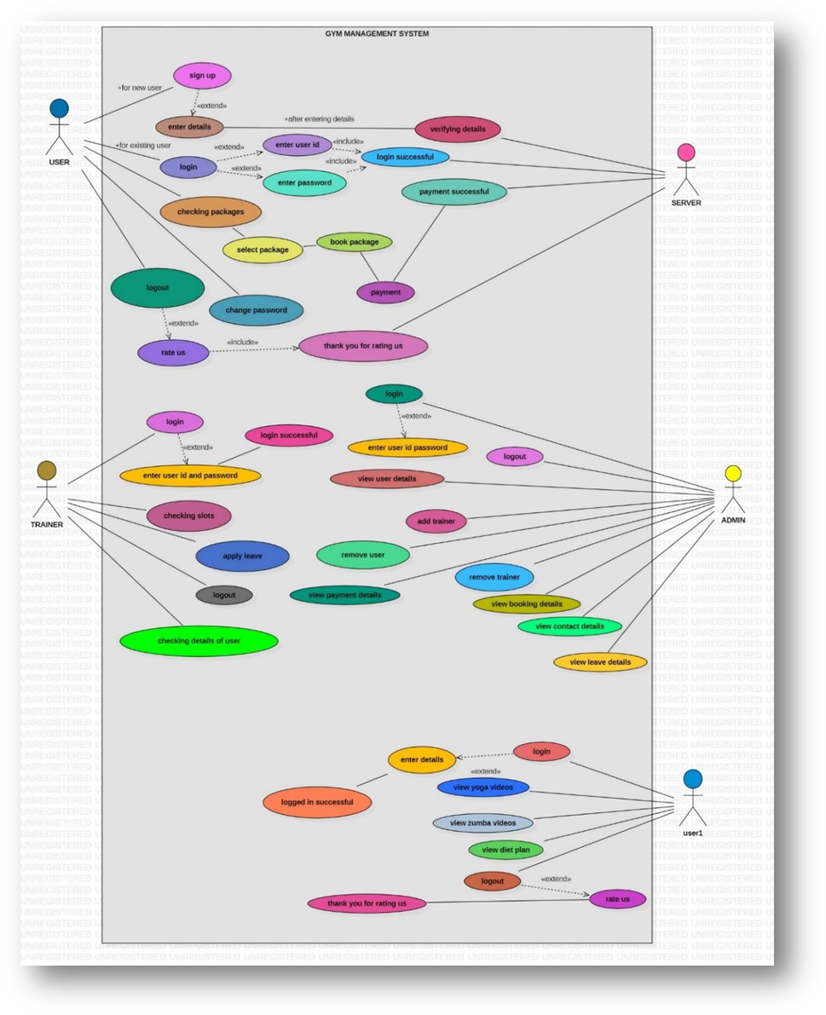
UML Diagrams
USE Case Diagram
Use case diagrams describe relationships between users and use
cases
A use case is a (usually high-level) user activity in the system
A use case is a collection of related success and failure scenarios
that describe actors using a system to support a goal
A use case name should generally begin with a verb
A use case diagram contains four components.
i. The boundary, which defines the system of interest in relation to the world around it.
ii. The actors, usually individuals involved with the system defined according to their roles.
iii. The use cases, which the specific roles are played by the actors within and around the system.
iv. The relationships between and among the actors and the use cases.

Slide 4
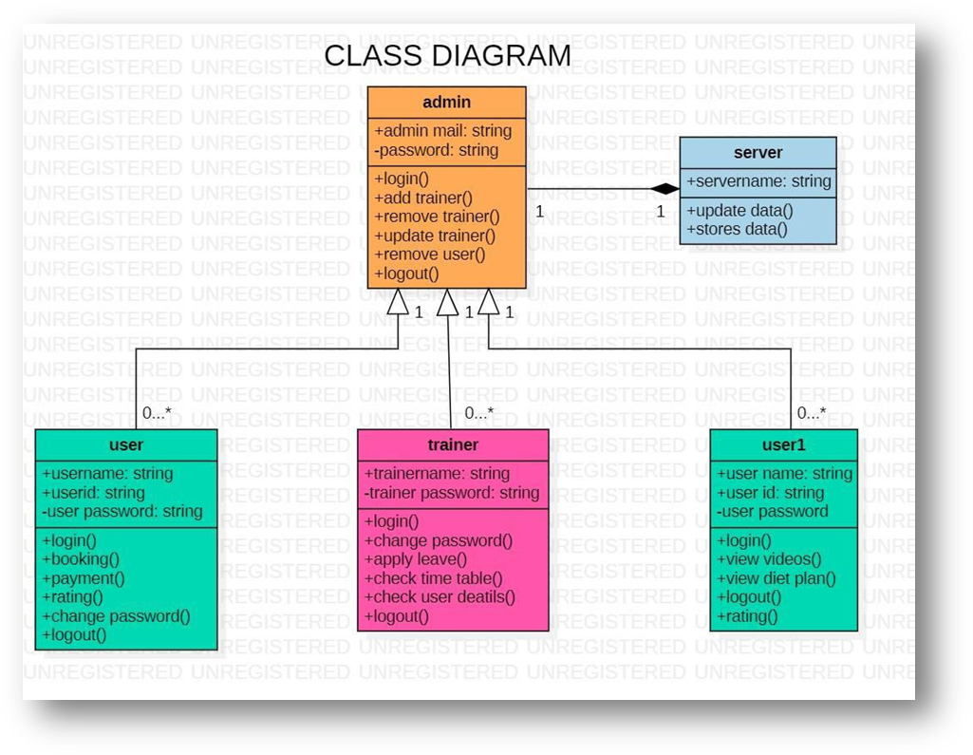
Class Diagram
The class diagram is a static diagram.
- A class model captures the static structure of a system by characterizing the objects in the system, the
relationship between the objects, and the attributes and operations for each class of objects.
- The class diagram can be mapped directly with object oriented languages.
- The class model is the most important amonethe three models.
- Class diagram provide a graphical notation for modeling classes and their relationship.
- They are concise, easy to understand, and work well in practice.
- Class diagrams are the backbone of almost every object-oriented method including UML.
- They describe the static structure of a system.

Slide 5
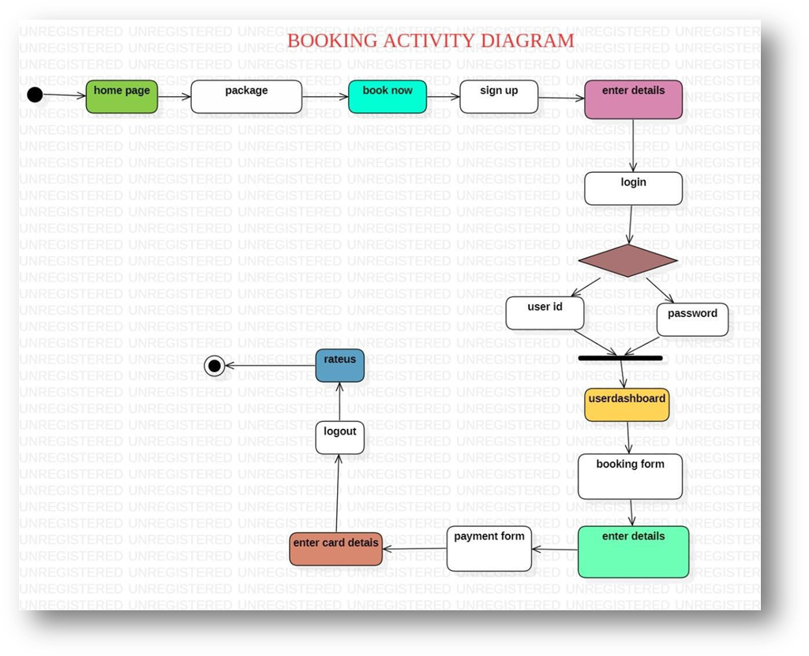
Activity Diagram
An activity diagram is a type of flow chart with additional support for parallel behavior.
- This diagram explains overall flow of control.
- Activity diagram is another important diagram in UML to describe dynamic aspects of the system.
- Activity diagram is basically a flow chart to represent the flow from one activity to another activity
- The activity can be described as an operation of the system.
- The control flow is drawn from one operation to another. This flow can be sequential, branched or
concurrent. This distinction is important for a distributed system.
- Activity diagrams deals with all type of flow control by using different elements like fork, join etc.
Notes:
(These don’t have designer IDs since they were based off the default master slides already in the deck.

Slide 6
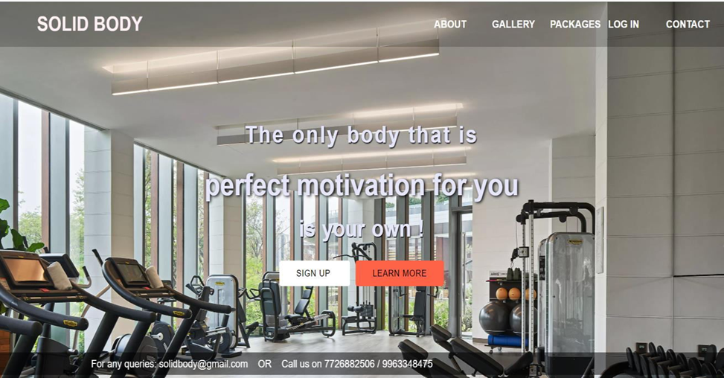
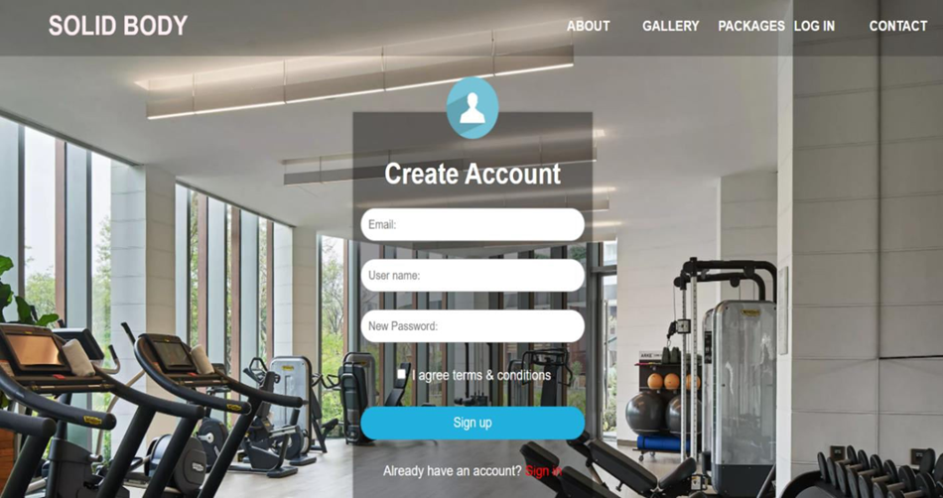
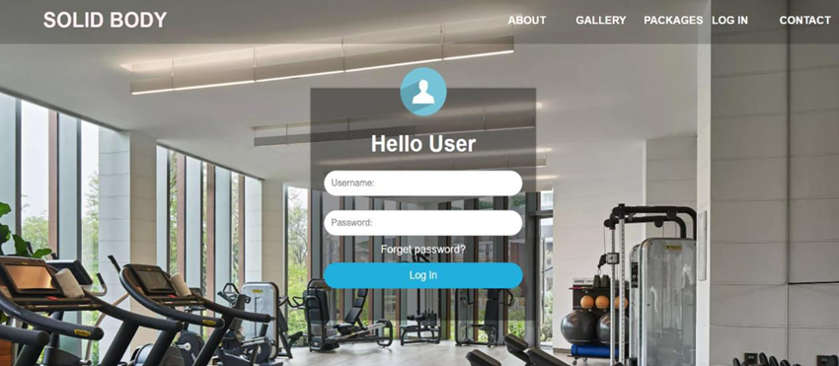
Main Page
Sign up
Login

Slide 7
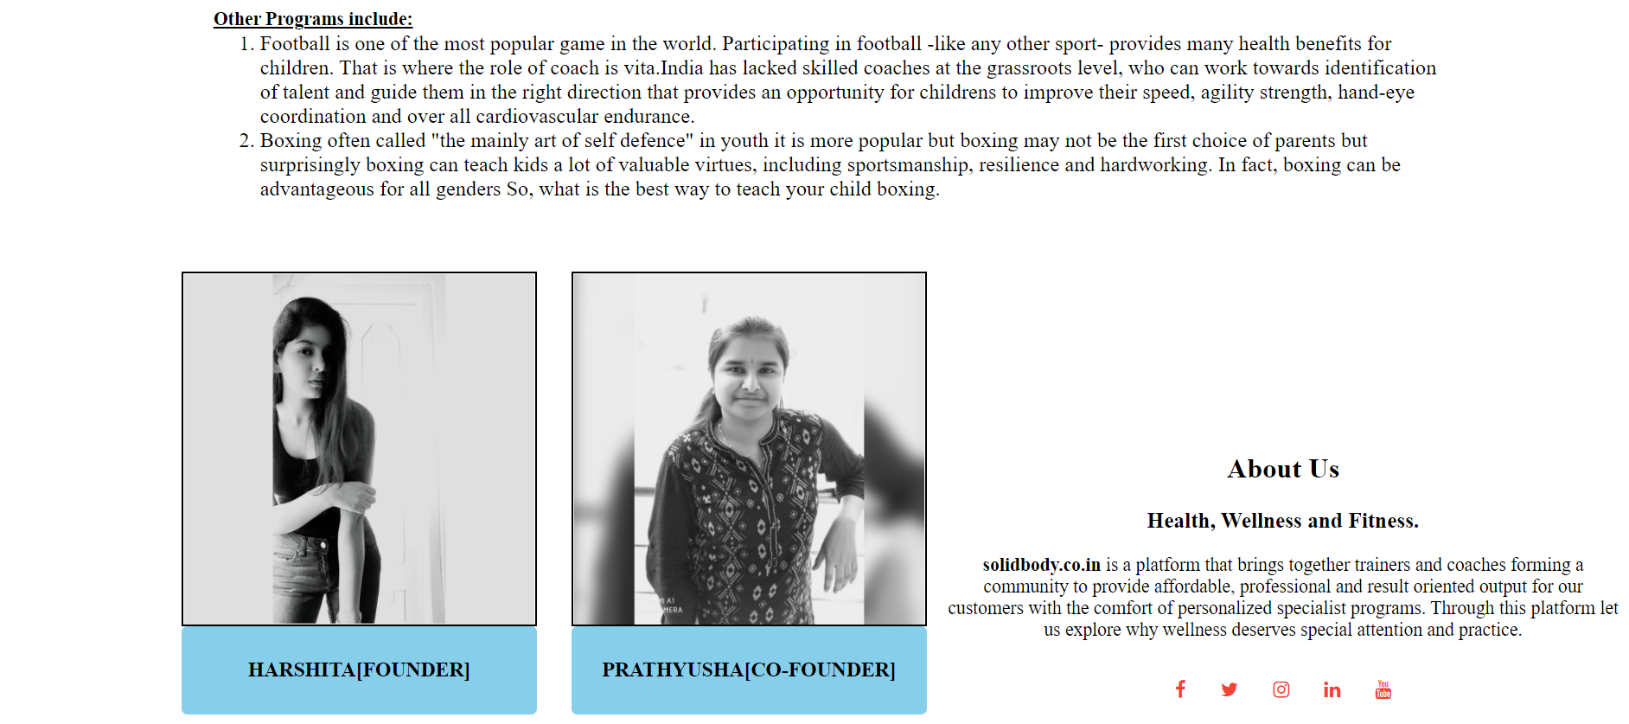
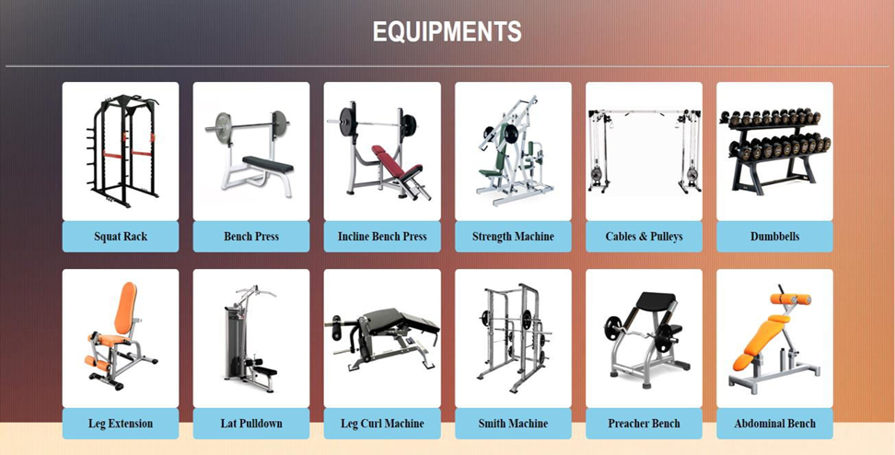
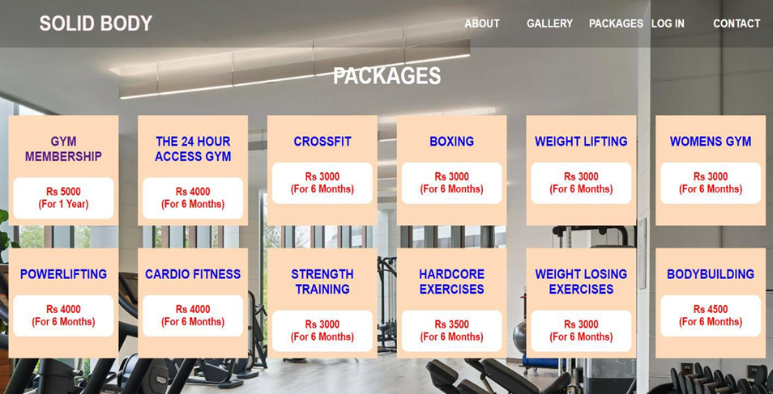
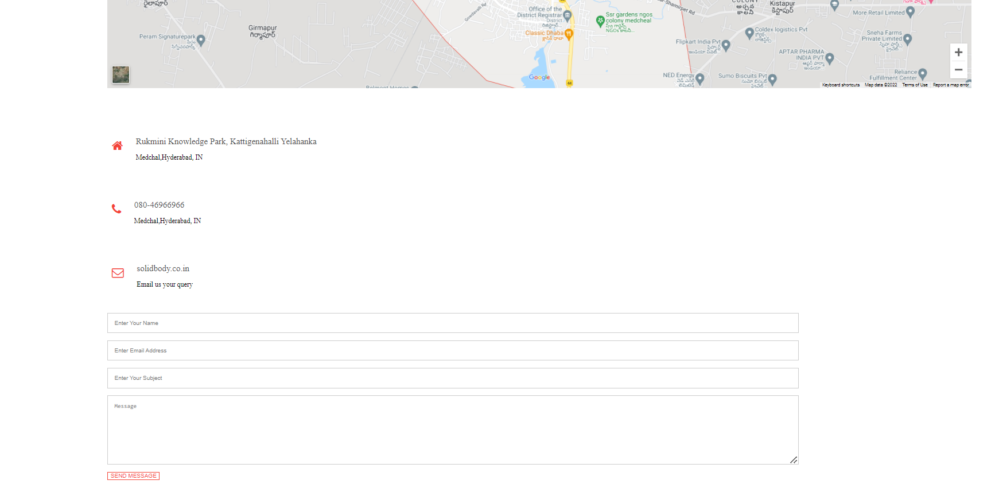
About Page
Gallery Page
Packages Page
Contact Page

Slide 8
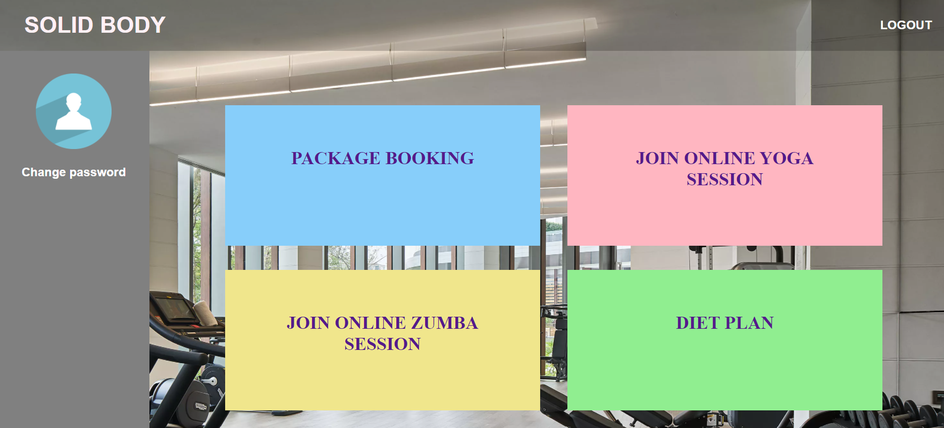
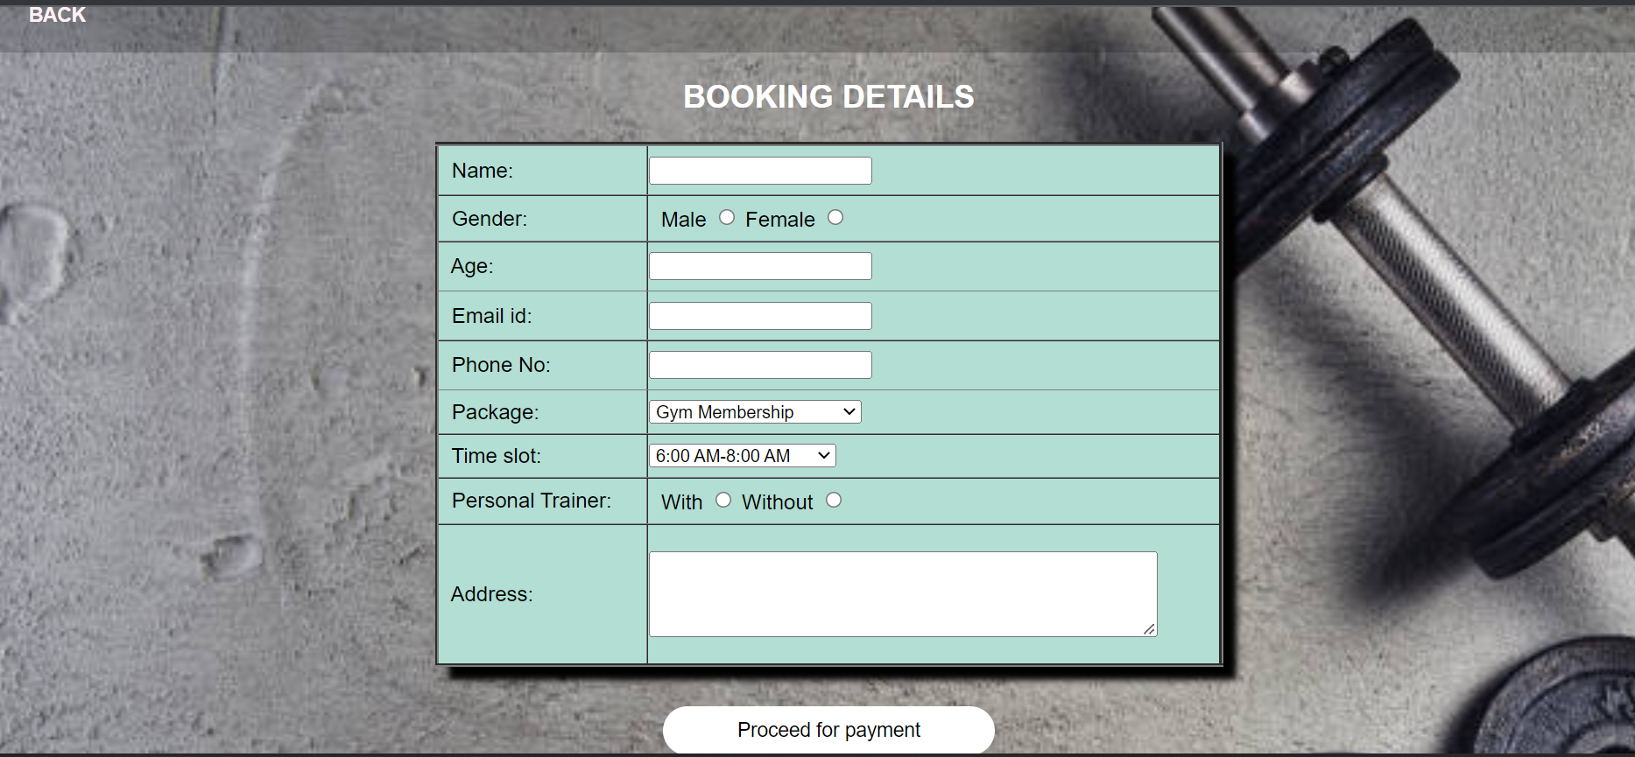
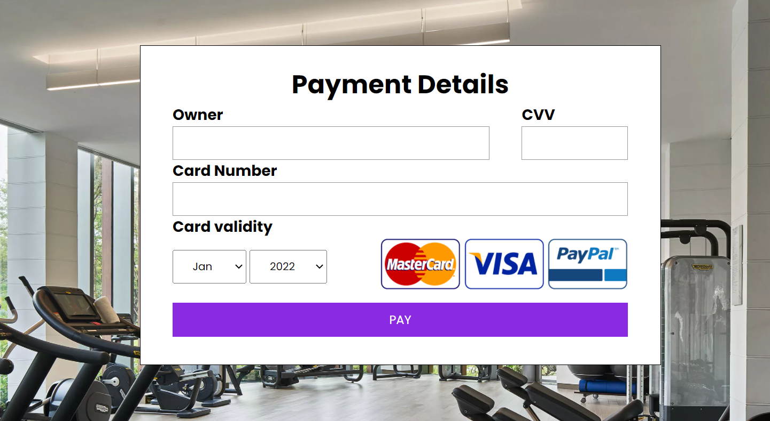
User dashboard Page
Package Booking Page
Payment Page

Slide 9

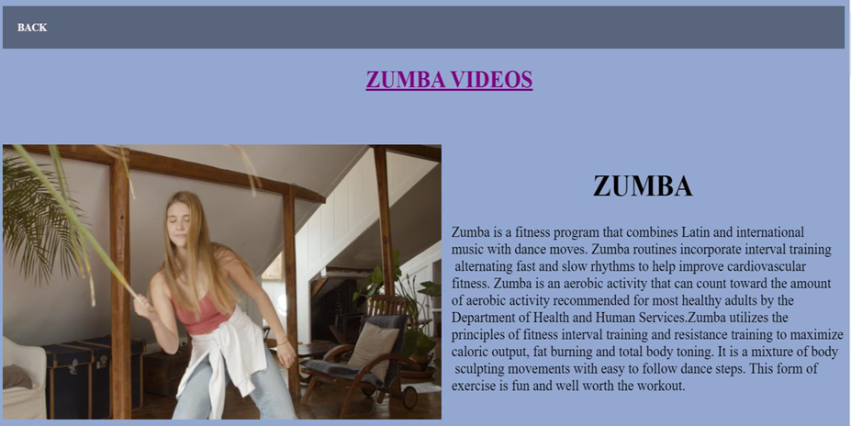

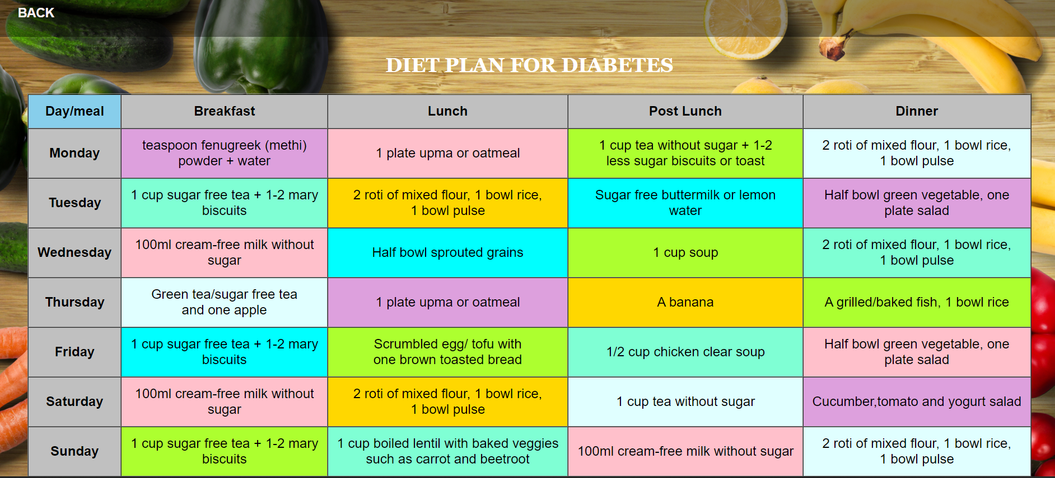
Yoga Videos
Zumba Videos
Diet Plan
Diet Plan For Diabetes

Slide 10
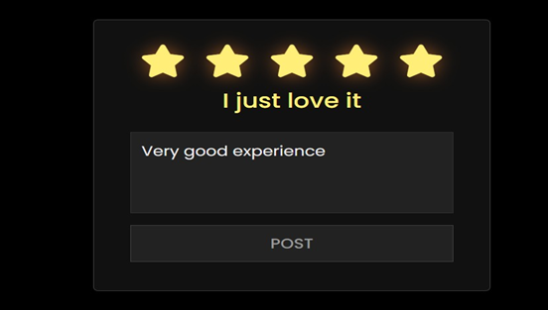
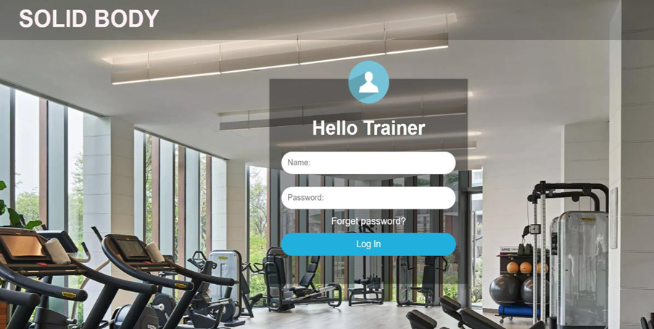
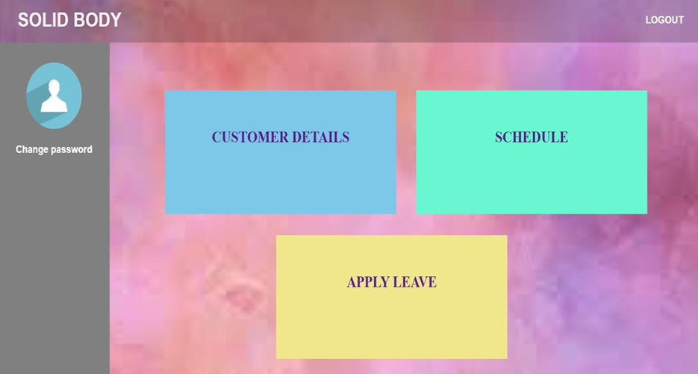
Rating Page
Trainer Login Page
Trainer Dashboard

Slide 11
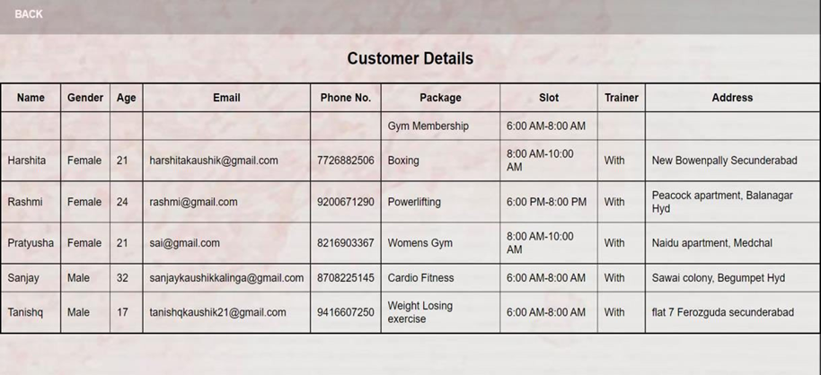
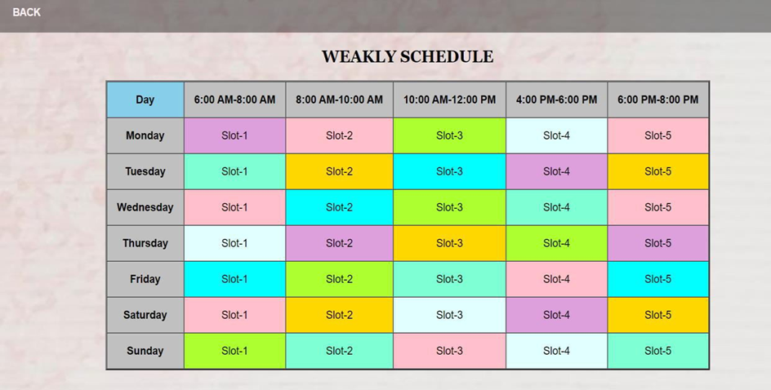
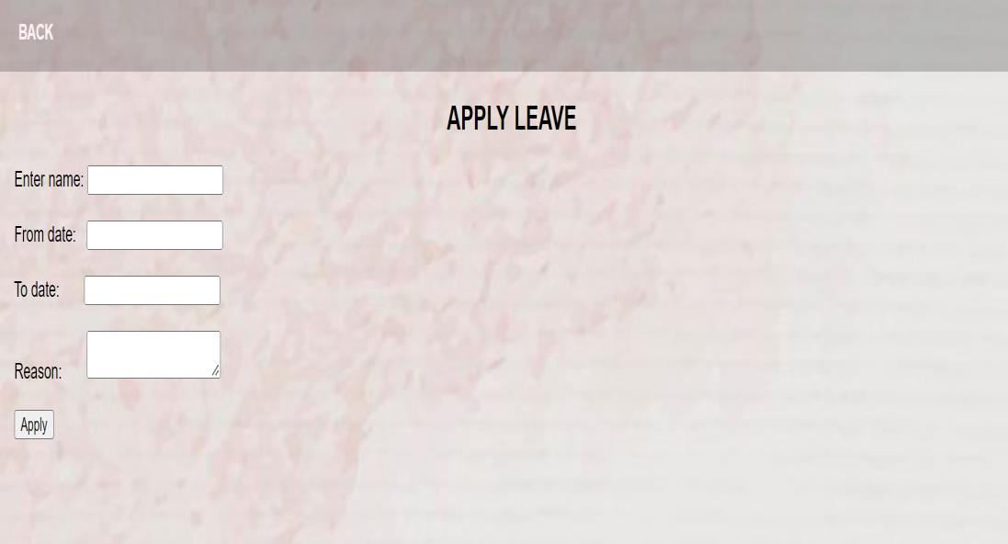
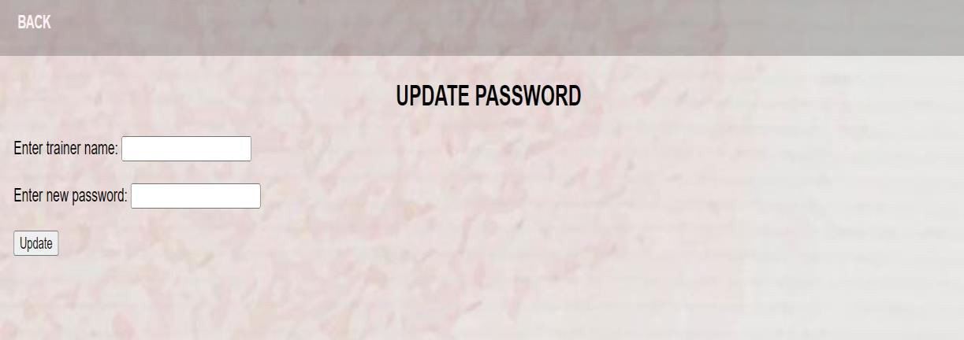
Customer Details
Weakly Schedule
Apply Leave
Update Password

Slide 12
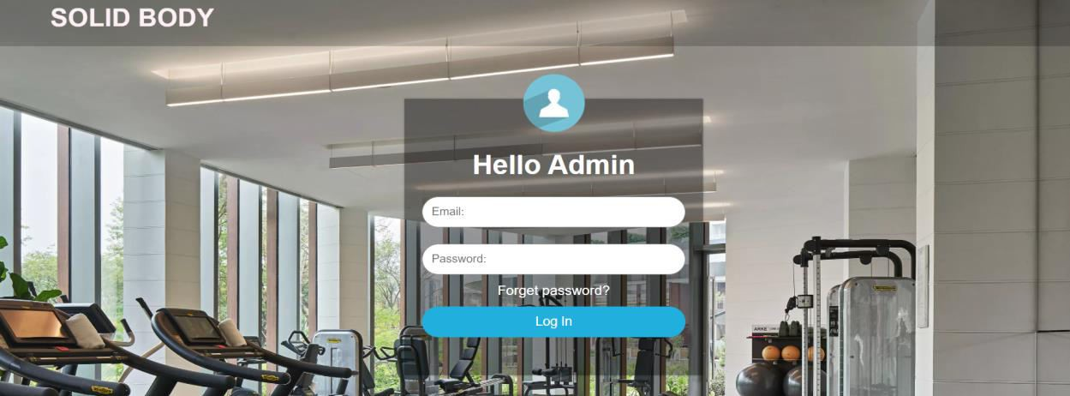
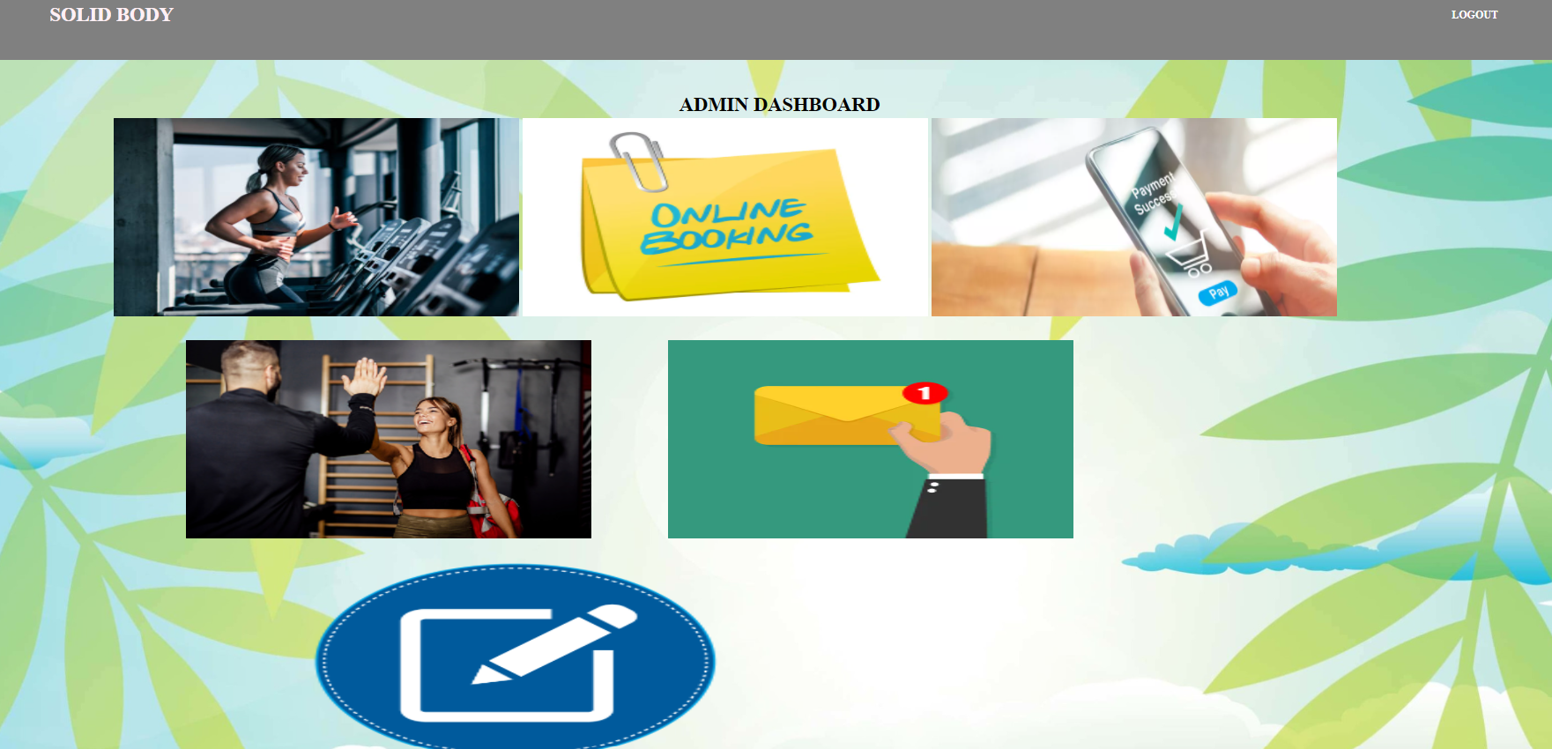
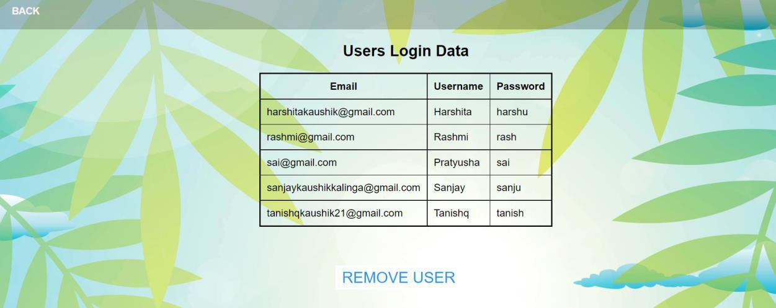
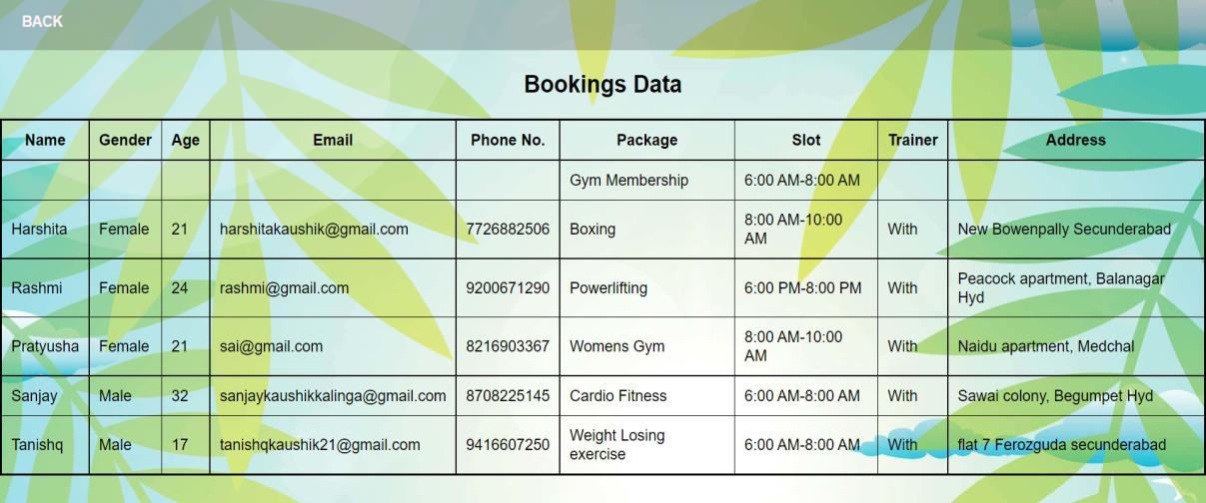
Admin login
Admin Dashboard
User Login Details
Booking Details

Slide 13
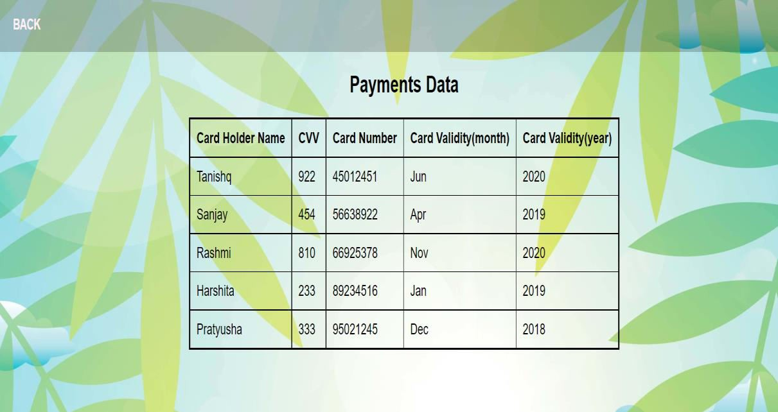
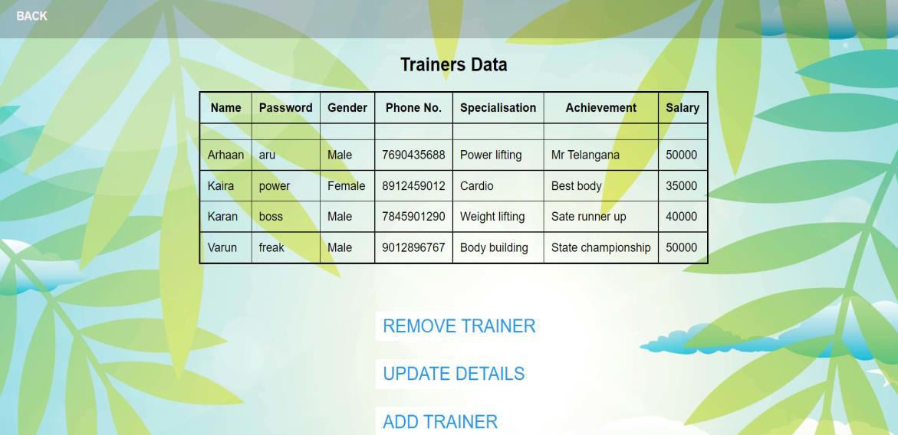
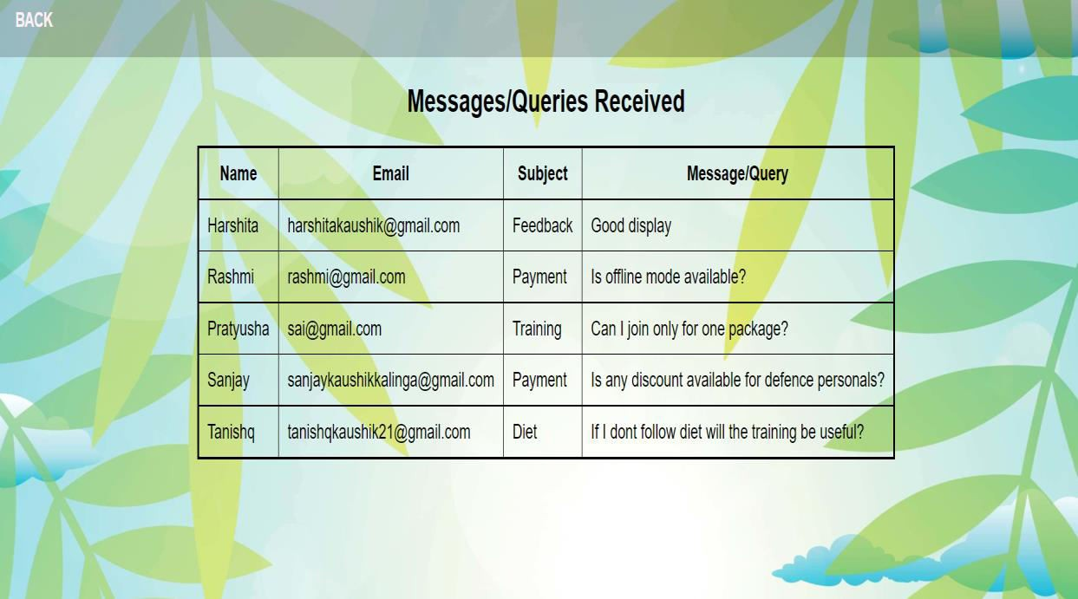
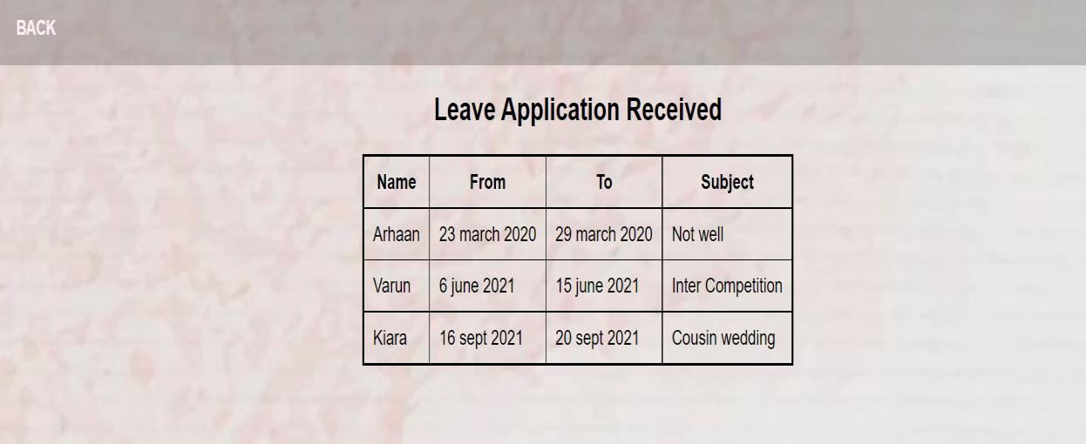
Payment Data
Trainers Data
Messages Received
Leave Applications Received

Slide 14
Limitations
Gym Management System project is always a room for improvement, it should be flexible enough for future modifications. The “Gym Management System” website although having many functionalities and being user-friendly has a few limitations.
Since it is an online project, users need good and stable internet connection.
Not offering a monthly package booking.
Data security
People who are not familiar with computers can’t use this website.
There is no option for cancellation of booking or refund.
The system fails if the server fails.

Slide 15
Conclusion
The demand of Web application for application is increasing day by day in Software industry, due to high expectations of client companies.
Hence an attempt of automating an office application had added to our learning experience.
It has also helped in adopting an analytical approach to solving and made us realize that system development is a step-by-step process.
Our project Gym Management System provides user to make package booking online. It provides user with a provision to view content of all the packages offered by the gym and can search the services in detail and can make a booking. This system holds information about gym members, equipments, packages, trainers and also diet plan.
This project has proven to be a worthwhile exercise for us !! Stay healthy…

Slide 16
Future improvisation
This “Gym Management System” involves all the features of the online booking. The future implementation will be online help for the users and contacting us through website.
Our marketing strategy will be based mainly on ensuring fitness freaks know about our existence and the services we fulfil. Hence our intention is to make the right information available to the right target users. We will ensure that our prices take into consideration people’s budgets that these people appreciate the services, know that it exists, and how to contact us.
Our services will be positioned very carefully, they will be of extremely high quality, comfortable, informative and tailored to the user’s needs. And will definitely work on the feedbacks given by our users for making our services better.
We will aware people about the benefits that physical activities are cure for many diseases from which lot of people suffering now a days.
Spending on gym was earlier seen luxury, but now it is a way of life, health and fitness will continue to remain at the forefront for all of us.

Slide 17


Thank you
Harshita[121319043018]
Sai Prathyusha[121319043026]
121319043018@sfc.ac.in
121319043026@sfc.ac.in
Gym Management System

